Slide 1



Where are the WholEUGrain countries in establishing their own partnerships?
-SLOVENIA-
Dea Zavadlav, CCIS-CAFE
WholEUGrain Spring School, 29 March 2022

Slide 2



Where is Slovenia when we are talking about whole grain partnership?
Stakeholder web event „Let's talk abut grains – whole grains!
(9/2020)
WholEUGrain Summer School (5/2021)
Whole grain event in the framework of Slovenian presidency to EU Council (11/2021)
WholEUGrain Spring School
(3/2022)
WholEUGrain project partners and stakeholder meeting in Slovenia
(5/2022)
First meeting of Slovenian stakeholders (11/2021)
Consultations with DVFA, DCS and Slovenian food companies
(1/2022)
Bilateral meetings with Slovenian food companies (3&4/2022)
Slovenian whole grain partnership establishment (10/2022)

Slide 3
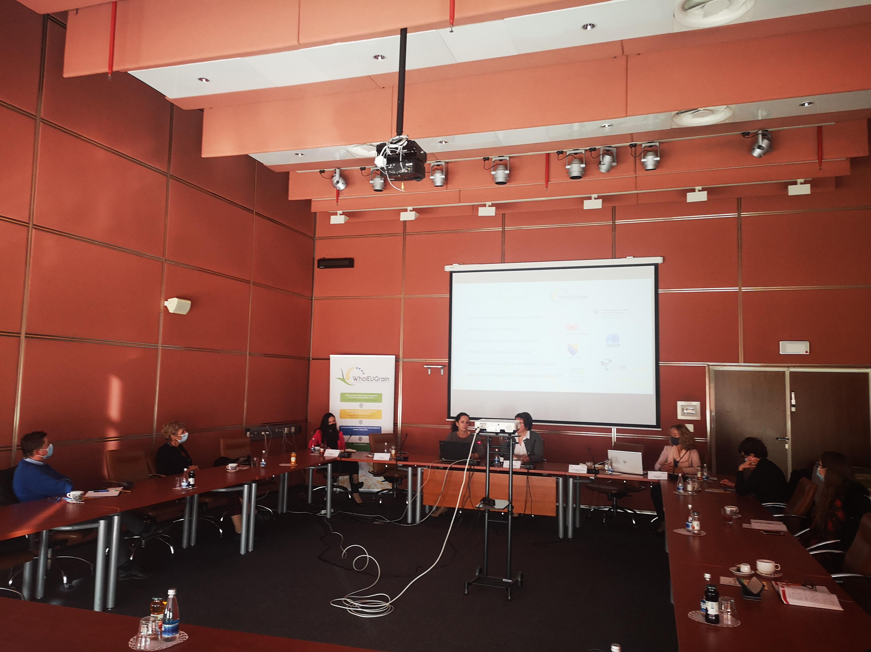



First meeting of Slovenian stakeholders
„What is the future of whole grain products?“
November 2021

Slide 4

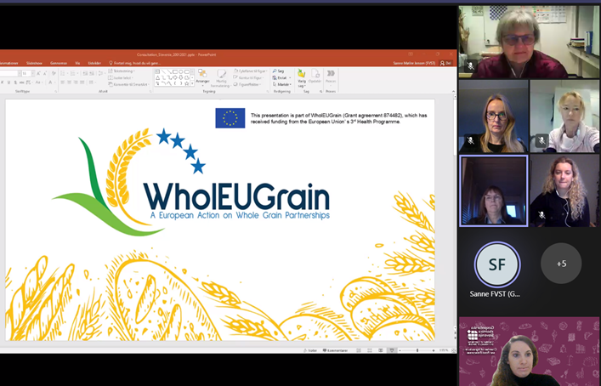
Consultations with DVFA, DCS and Slovenian food companies
January 2022

Slide 5


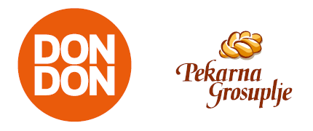
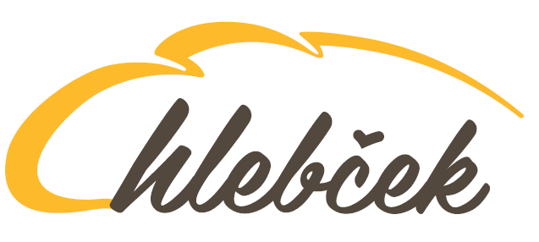
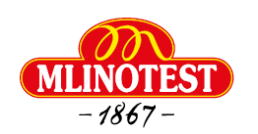
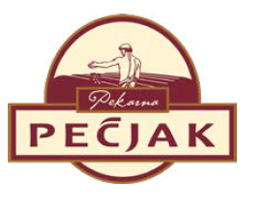
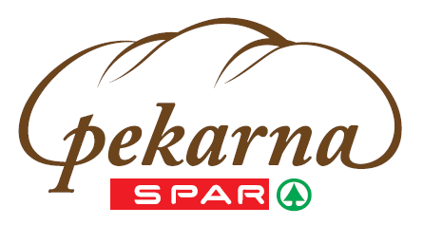
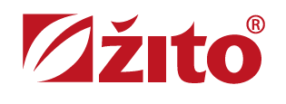

Bilateral meetings with Slovenian food companies
+ Others
March/April 2022

Slide 6


Thank you for your attention!
dea.zavadlav@gzs.si

